Slide 1

Vibe Sketch
Generative ai and its applications
Name SRN
Sujoy SEN PES2UG23CS621
Syed KAIFUDDIN PES2UG23CS636
TAHIR SHAFIQ PES2UG23CS639

Slide 2
Vibe Sketch is a Generative AI–based system that converts natural language descriptions into interactive UI prototypes.
It uses a vibe-coding approach, where AI generates frontend code (HTML, CSS, JavaScript) through prompts.
The system enables a prompt → generate → test → refine workflow for UI development.
It eliminates the need for manual coding and simplifies the prototyping process.
The final output is a working, browser-based UI prototype.
OVERVIEW

Slide 3
Rapid Prototyping: Quickly generate UI designs from simple text inputs.
No Coding Required: Reduces dependency on programming skills.
Iterative Development: Easy refinement using prompt-based updates.
Time Efficient: Speeds up design-to-development workflow.
Accessibility: Enables non-technical users to create UI prototypes.
KEY BENEFITS

Slide 4
Used in startup product development for quick idea visualization.
Supports UI/UX designers in rapid prototyping and iteration.
Helps students and developers build projects faster.
Applicable in no-code/low-code platforms powered by AI.
Reflects the growing trend of AI-assisted software development.
Real-World Relevance

Slide 5
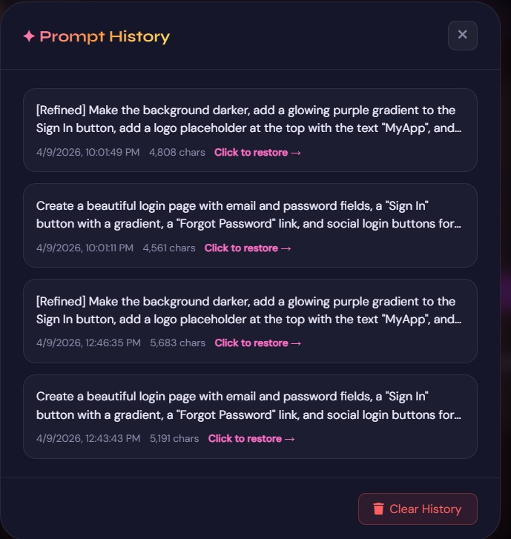
PROMPT HISTORY

Slide 6
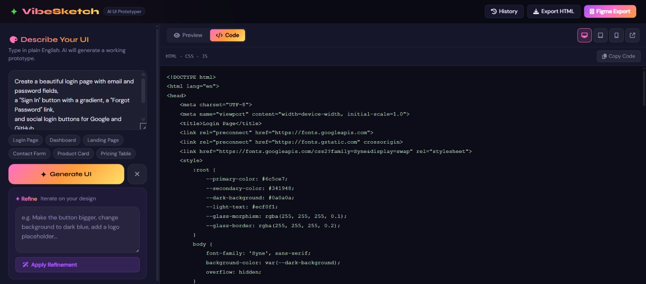
CODE GENERATION

Slide 7
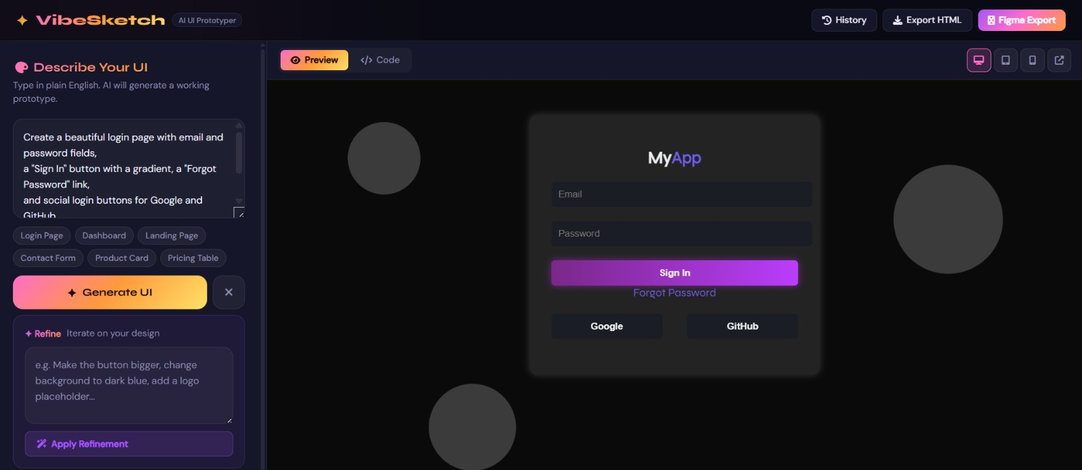
UI

Slide 8
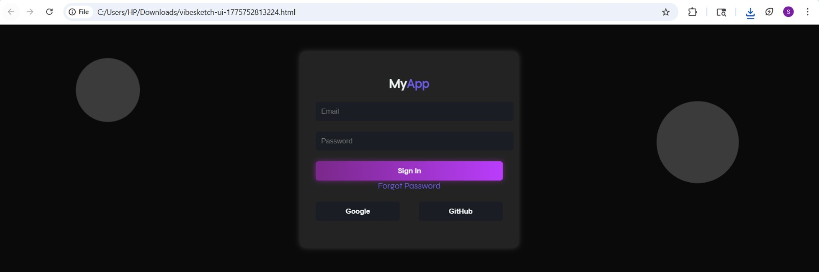
EXPORT HTML

Slide 9
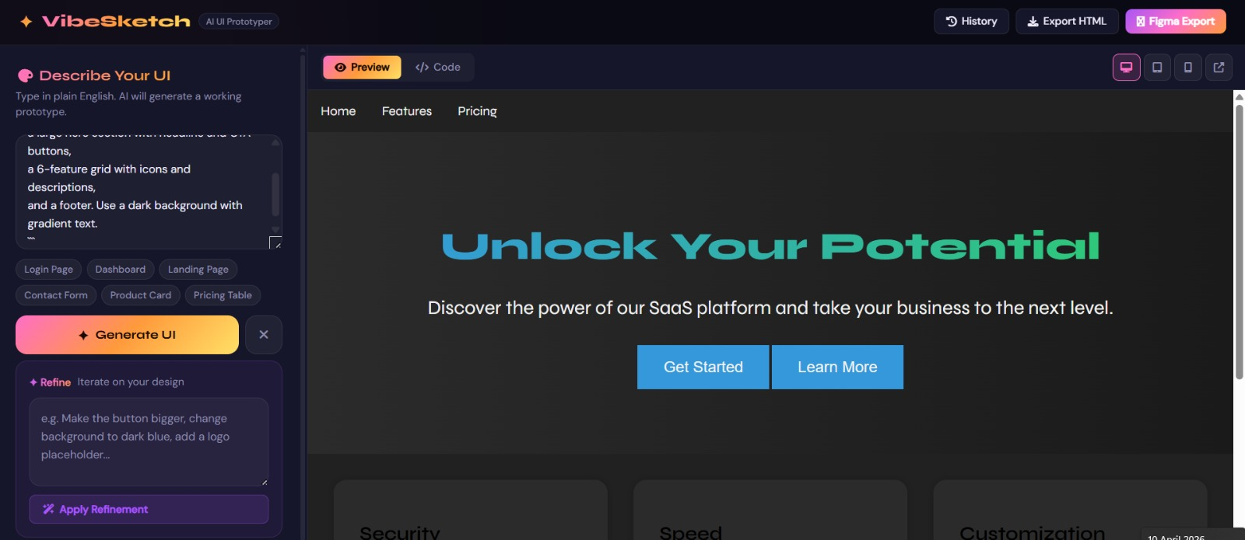
BEFORE REFINED PROMPT OUTPUT

Slide 10
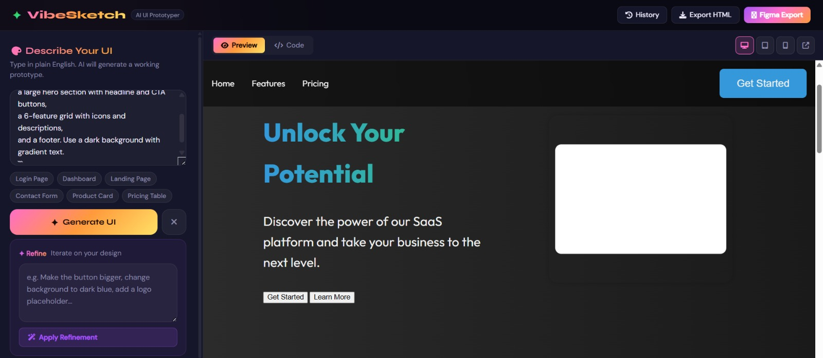
REFINED PROMPT OUTPUT

Slide 11
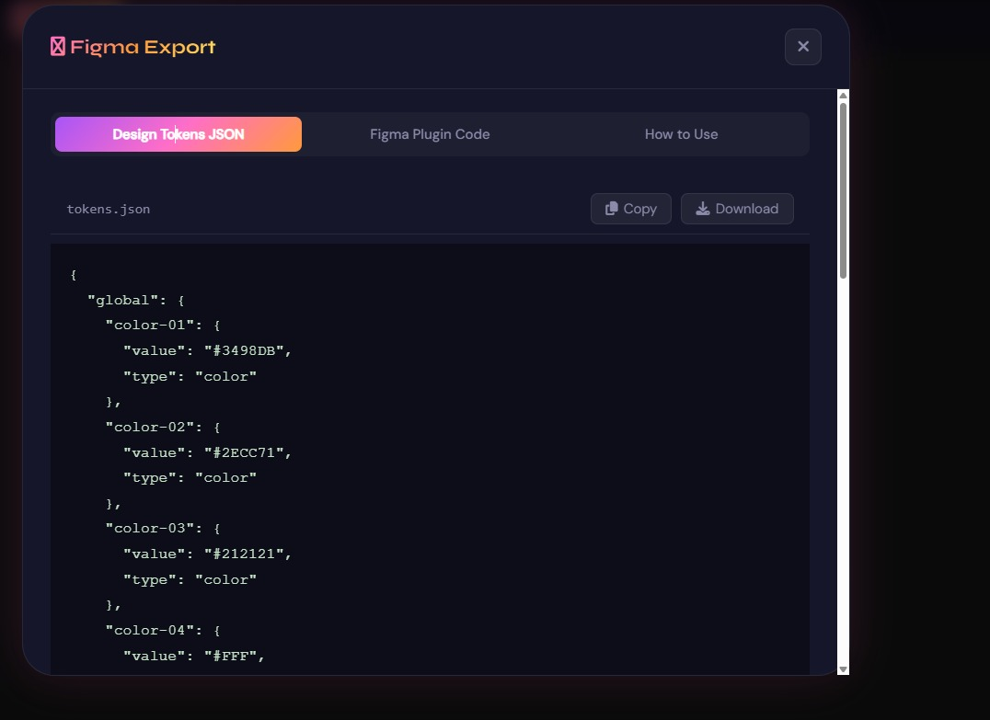
FIGMA EXPORT- DESIGN TOKEN JSON

Slide 12
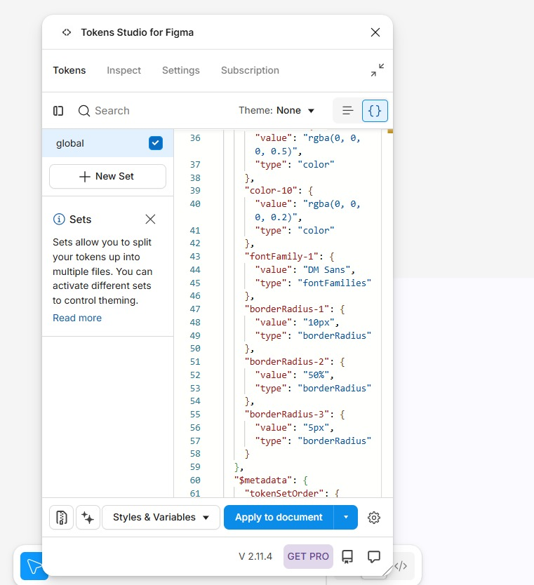
FIGMA EXPORT- TOKEN STUDIO FOR FIGMA

Slide 13
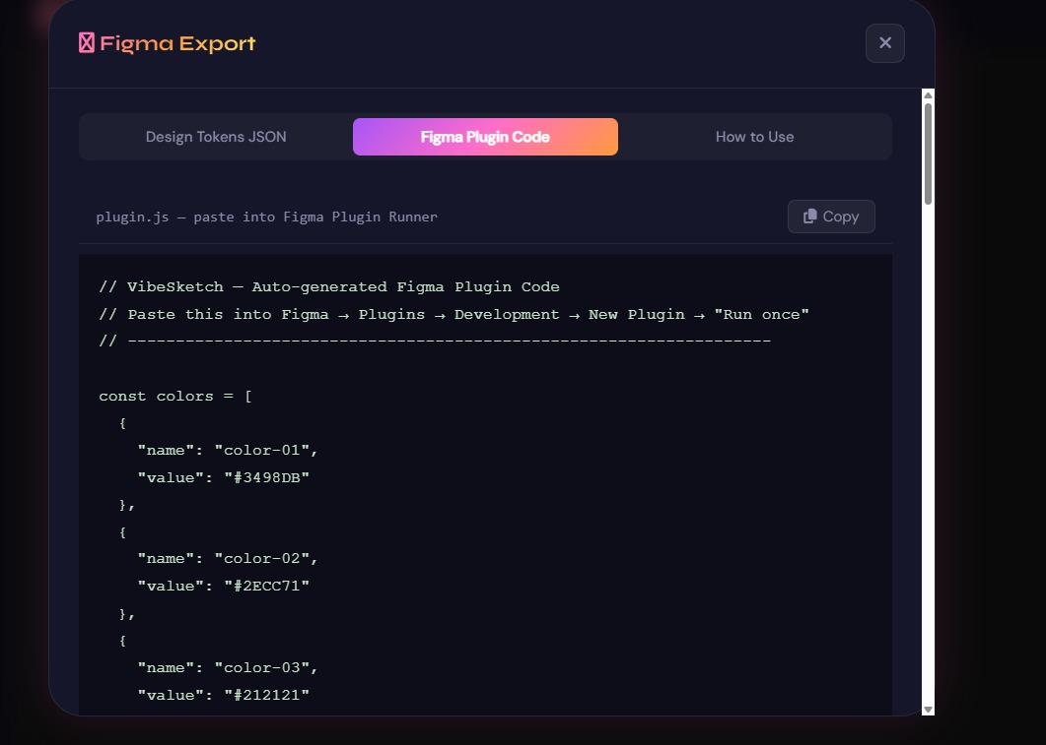
FIGMA EXPORT- FIGMA PLUGIN CODE

Slide 14
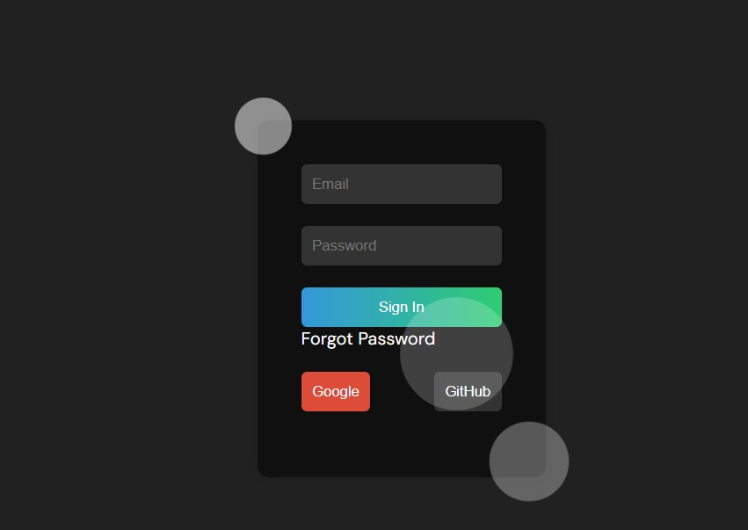
UI GENERATED

Slide 15
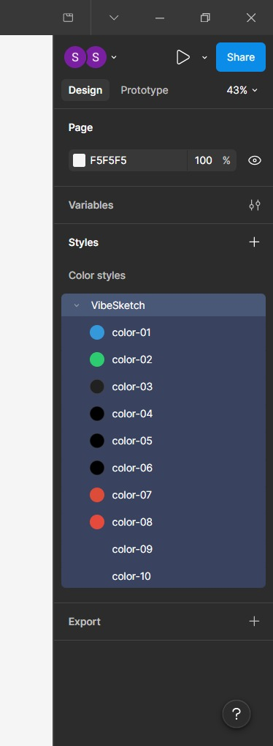
COLOUR PALETTE OF UI

